Slide 1
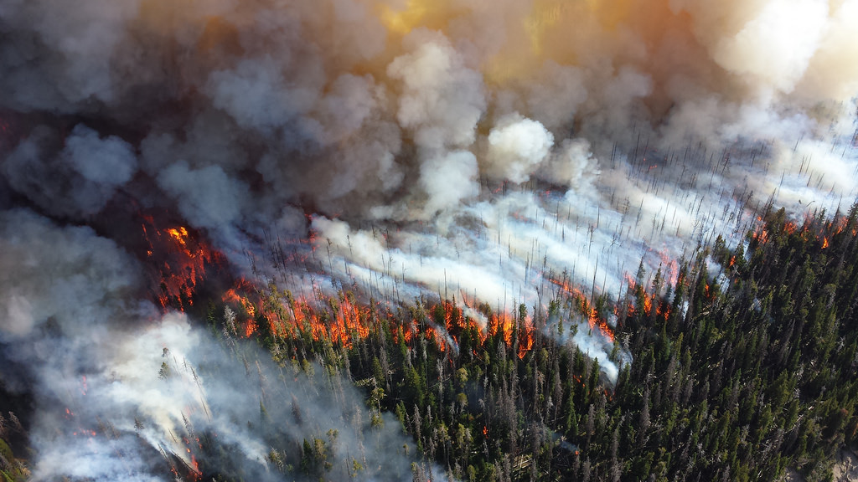
Fuel Type Layer Project
BC Wildfire Service and Digital Platforms and Data Division
March 2021

Slide 2
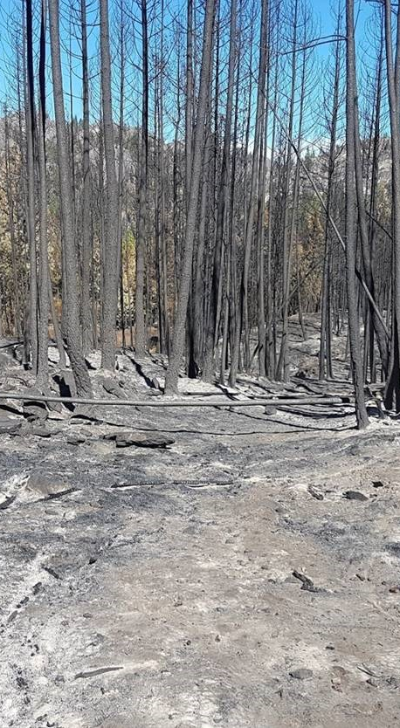
The Problem
The Fuel Type Layer data set is fundamentally critical for informed decisions re: wildfire risk threat assessment, fuel reduction burning and wildfire operations.
Significant known errors in existing data
At present: many thousands of hectares poorly mapped in BC
Wildfire operations (>$200M in 2020) and risk reduction programs ($30M in 2020) impacted by poor quality of existing data

Slide 3
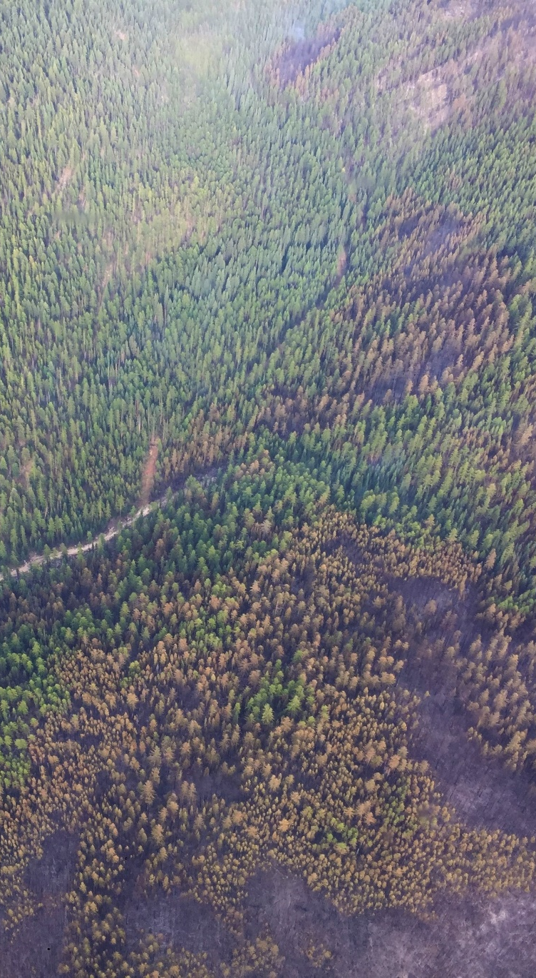
The Solution
Use data scientists to build a tool that uses satellite data and advanced data science techniques to map vegetation (fuels)
Partnership between BC Wildfire Service subject matter expects and Digital Platforms and Data Division
Build prototype service tailored for BC Wildfire Services decision makers
Access large global satellite remote sensing and machine learning communities
Share data across government

Slide 4
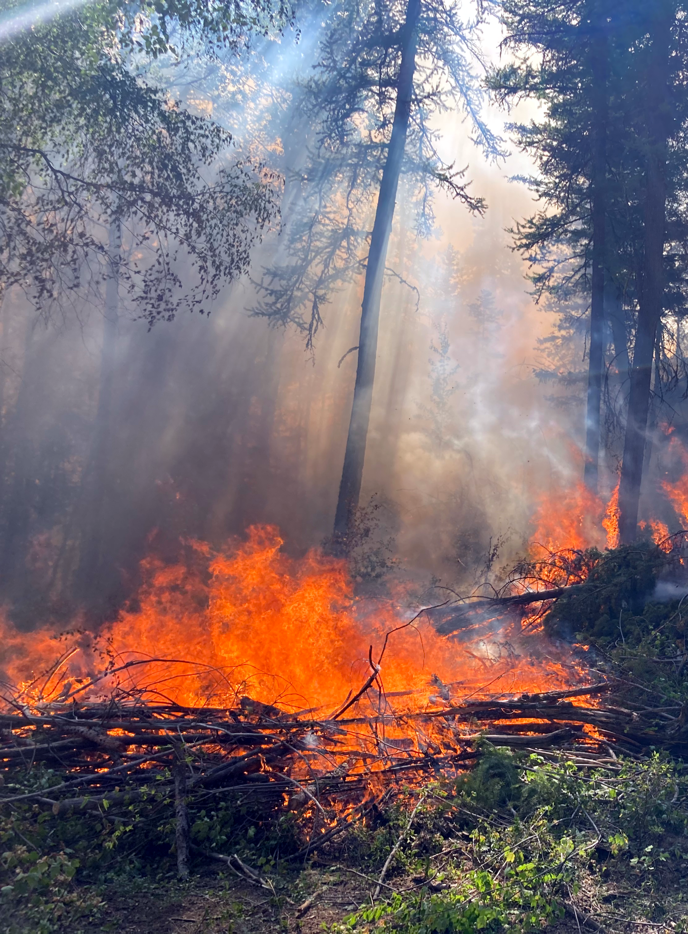
The Pilot
Satellite imagery collected for Telegraph Creek, BC
Field data collected by Senior Fire Protection Officer
New fuels information produced using in-house minimum viable product software
Fire simulations performed to assess impact of new info products, for operational decision making

Slide 5
Results: Telegraph Creek Study

Slide 6
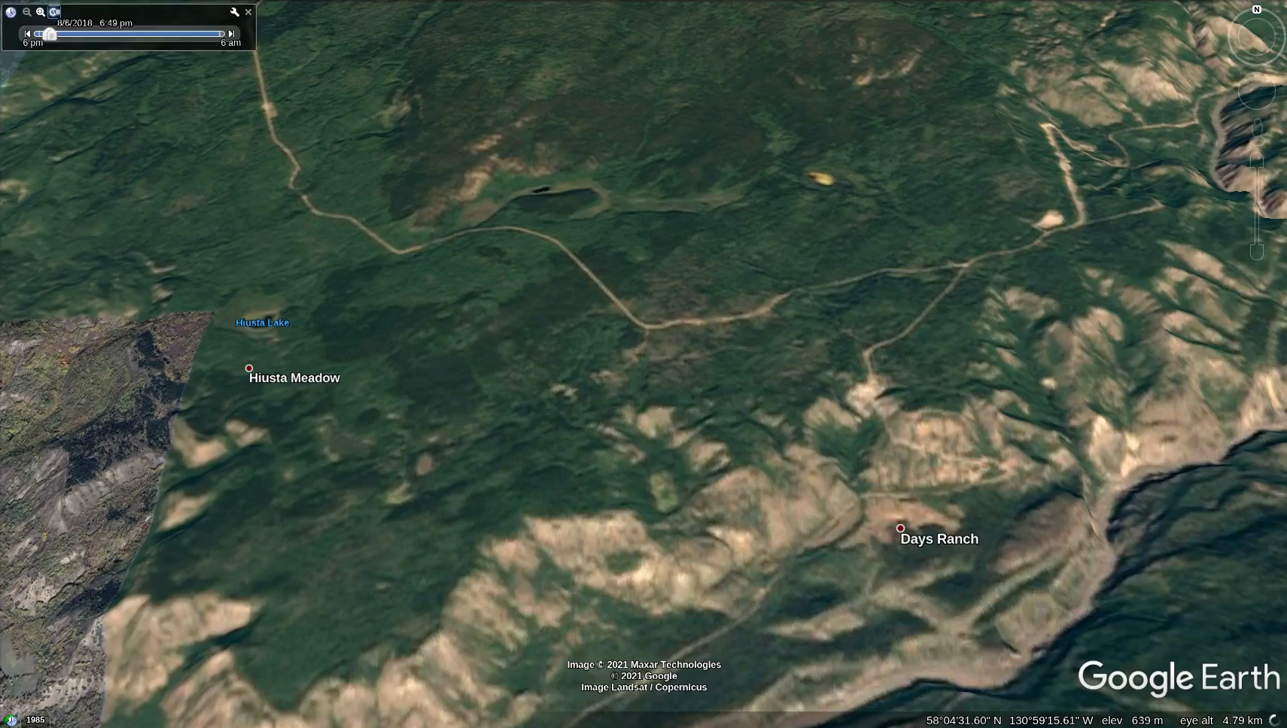
Fire Simulation: VRI-based FTL

Slide 7

Fire Simulation: FTL project

Slide 8
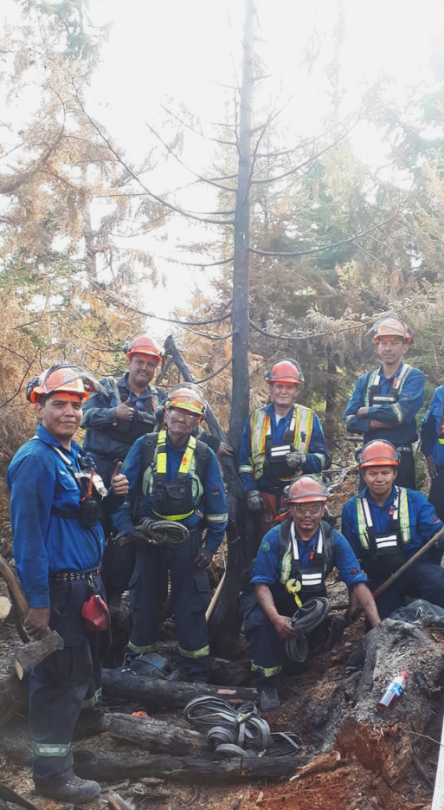
Impact to BC Communities
Improved decision-making during wildfire operations; improved effectiveness of fuel management activities.
Enhanced capability to:
Predict wildfire activity to help prioritize resource allocation
Prioritize and inform community fuel management projects in the Community Resiliency Investment Program
Assess, map and manage wildfire threats to people, industry and environment

Slide 9
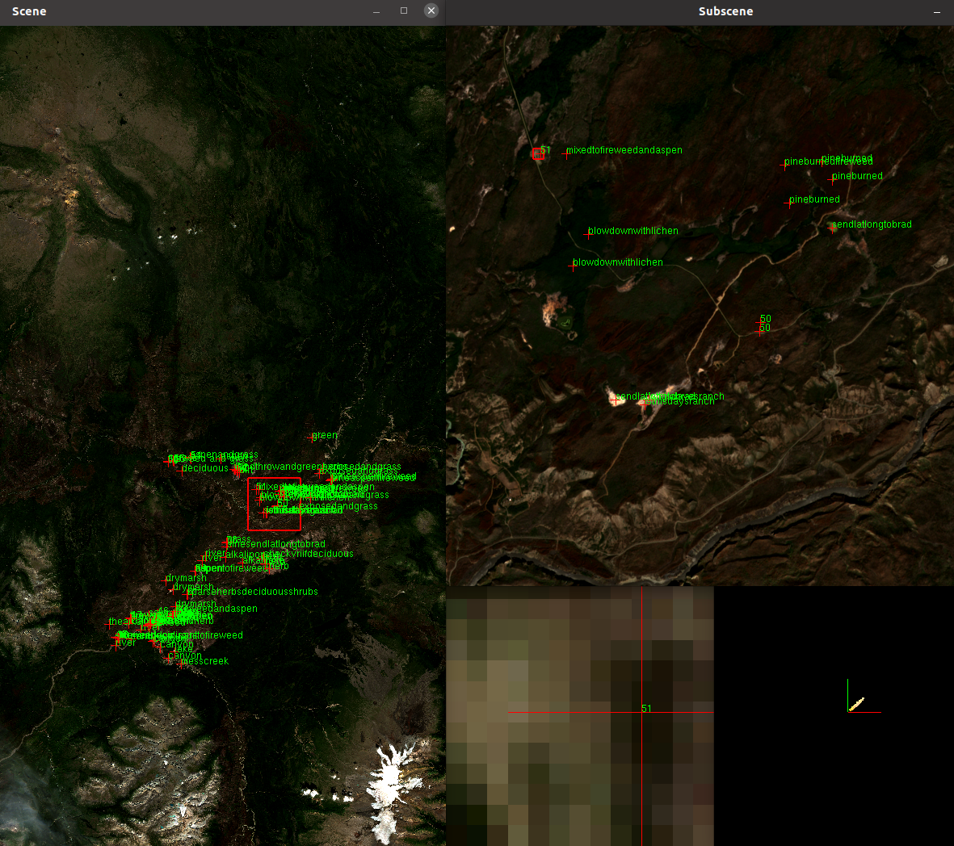
Outcomes
Minimal Viable Product (MVP) software to support:
BC Wildfire Service staff to evaluate new satellite data sources in combination with observed field data
Machine Learning methods to map wide areas of the Province
Improved fire science understanding of landscape changes: to inform enhanced planning and direction of fuel management activities, for years in advance

Slide 10
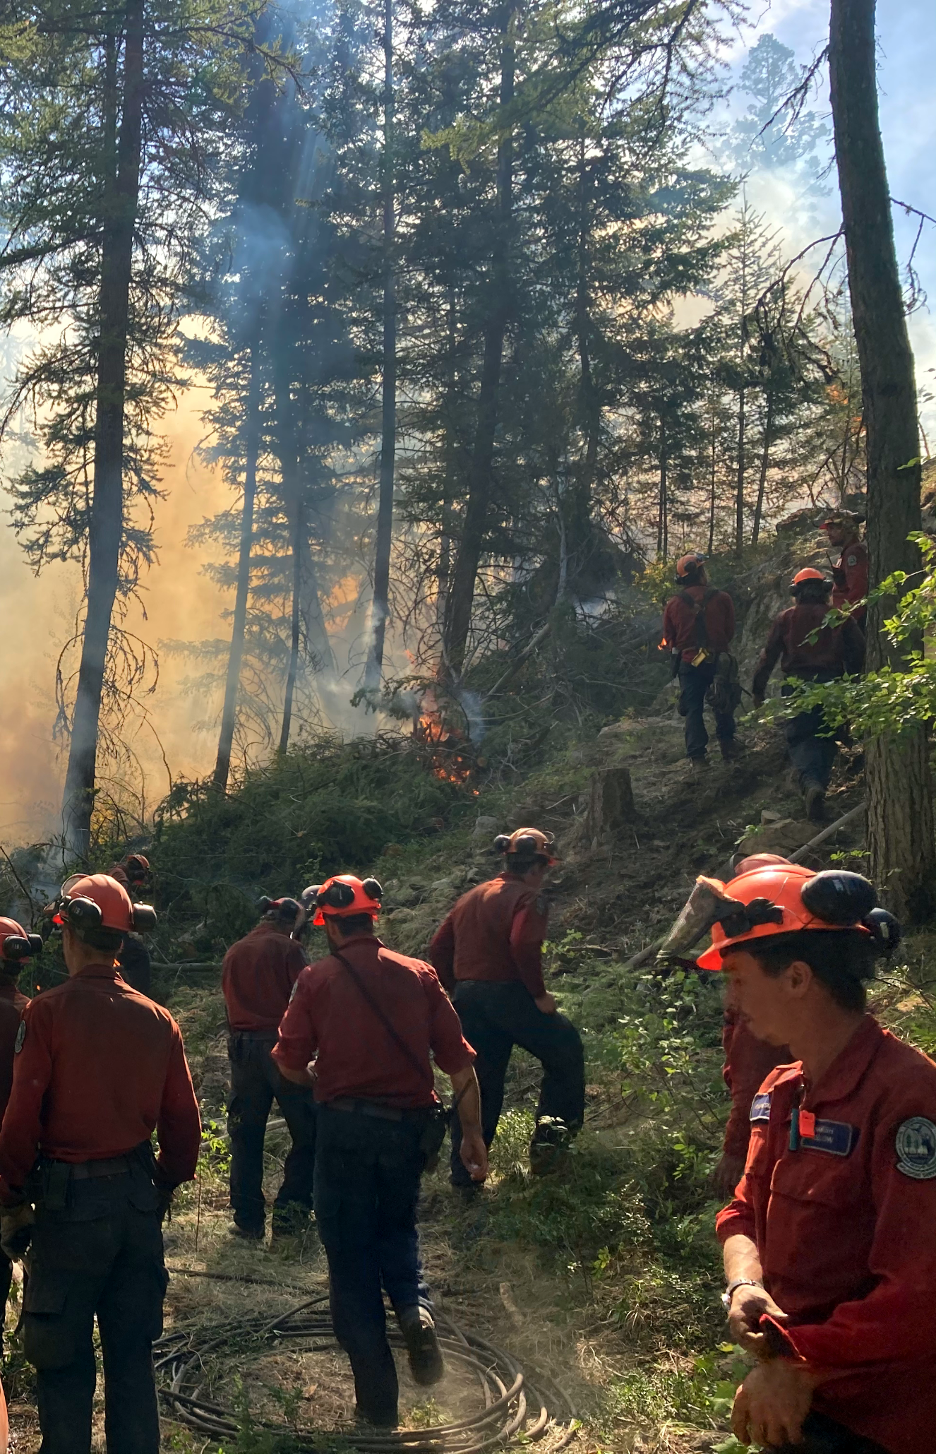
BC Wildfire Service Next Steps
Data sharing agreements, human capacity and modest IT infrastructure needed, to scale up to province-wide solution
Expand BCWS data-collection activities using our mobile FTL Survey123 App
Invest in in-house tech capacity to extract value for BC from rapidly expanding high-quality, free satellite data options e.g. new advanced tech that penetrates cloud and smoke
Continue research & development collaboration with research partners to leverage advances in satellite data and methods

Slide 11
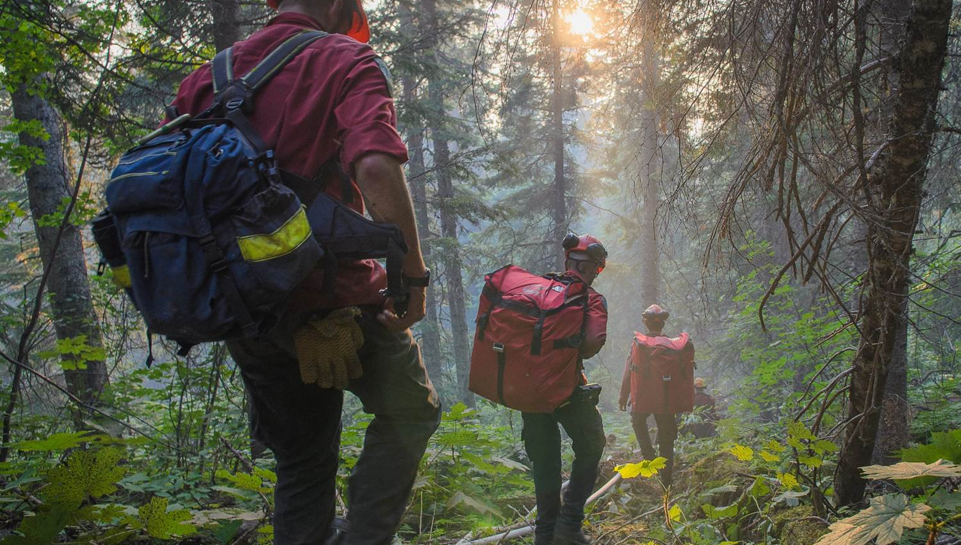
Questions?

